Slide 1


Frontiers in Smart Healthy Ageing
AIHA 8122
Kefeng Li, PhD
PhD Program Coordinator, AI-Empowered Smart Healthy Ageing (AIHA)
E-mail: kefengl@mpu.edu.mo
Office hour: Friday 3 - 4 pm, Bldg 11 Room 206 (Hengqin Campus)
Other time: New Academic Building E1303-1 (Main Campus, Macau)
Sep 4, 2026

Slide 2
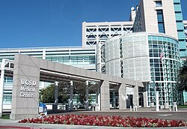
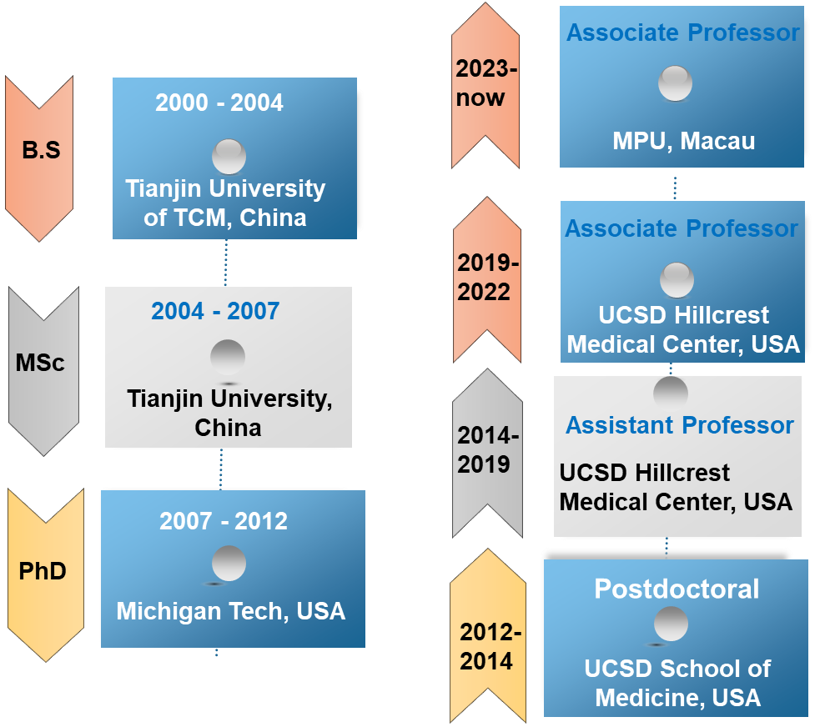

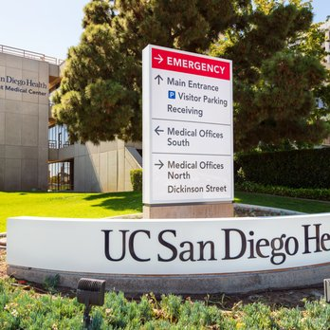

About Me

Slide 3
About Our Course
English-Only Environment: All instruction, materials, and discussions will be in English. We highly encourage you to actively participate and practice speaking
Attendance Policy: A minimum of 80% attendance is required to pass. Falling below this threshold will result in an automatic failure.
Assignment Submissions: Please complete and submit all assignments on time via the MPU Canvas system.
Class Schedule: Friday 19:00 – 22:00 pm. We will take a 10-minute break every hour to recharge.
Pop Quizzes: Unannounced, low-stakes quizzes may be given periodically to check understanding and reinforce your learning.
https://canvas.mpu.edu.mo/login/ldap

Slide 4

MPU Canvas Portal
https://canvas.mpu.edu.mo/login/ldap

Slide 5
Syllabus
Knowledge
Skills
Critical Thinking
Writing
Frontiers in Biostatistics and Bioinformatics (Lecture, 6 hours)
Frontiers in Artificial Intelligence and Smart Care (Lecture, 6 hours)
AI and Causal-Inference Practical Skills (Lab, 6 hours)
LLM, Agent, and Data Practice Skills (Lab, 6 hours)
Multi-omics and Virtual Cell — Expert Seminar and Team Presentation ( Journal Club, 3 hours)
Chronic Disease Management and Medical Image Analysis — Expert Seminar and Team Presentation (Journal Club, 3 hours)
Emotional Care and Companion Robots — Expert Seminar and Team Presentation (Journal Club, 3 hours)
Home-Care Robots and BCI — Expert Seminar and Team Presentation (Journal Club, 3 hours)
Research Paper and Grant Writing (6 hours)
Final Project Oral Defense (3 hours)

Slide 6

Reference Books
1. Shai Shalev-Shwartz & Shai Ben-David (2014). Understanding Machine Learning: From Theory to Algorithms. Cambridge University Press.
2. Ian Goodfellow, Yoshua Bengio & Aaron Courville (2016). Deep Learning. MIT Press. http://www.deeplearningbook.org
3. Judea Pearl & Dana Mackenzie (2018). The Book of Why: The New Science of Cause and Effect. Basic Books.
4. Kevin Murphy (2022). Probabilistic Machine Learning: An Introduction. MIT Press.
5. Aurélien Géron (2022). Hands-On Machine Learning with Scikit-Learn, Keras, and TensorFlow, 3rd Ed., O'Reilly Media.
6. Stuart Russell & Peter Norvig (2021). Artificial Intelligence: A Modern Approach, 4th Ed., Prentice Hall.
7. Tom B. Brown et al. (2020). "Language Models are Few-Shot Learners" (GPT-3), NeurIPS 2020.
8. Ashish Vaswani et al. (2017). "Attention Is All You Need", NeurIPS 2017.
The Book of Why
Prof. Judea Pearl from UCLA
Turing Award

Slide 7
Session 1- Knowledge
Frontiers in Biostatistics and Bioinformatics (6 hours)

Slide 8
Frontiers in Biostatistics and Bioinformatics (6 hours)
Foundations of Biostatistics and Probability

Slide 9
Why Start with Basic Statistics?
Because every smart health model starts as a measurement problem.
Clinical question
→
Data collected
→
Statistical summary
→
Decision
Example: Does a fall-prevention program reduce 30-day fall risk in community-dwelling older adults?
• Without statistics, a difference may be only noise.
• Without domain context, a statistically significant result may be clinically trivial.
• This first section builds the vocabulary used later in causal inference, omics, and AI evaluation.

Slide 10
Session Map
From raw measurements to responsible reporting.
→
→
→
→
1
Describe data
2
Model uncertainty
3
Infer carefully
4
Compare many things
5
Report honestly
variables, scales, summaries
probability and sampling
CI, tests, power
multiplicity and FDR
effect size, CI, assumptions
Teaching rhythm: concept → tiny example → health ageing interpretation. This keeps the statistics grounded rather than abstract.
By the end, students should be able to read a simple biomedical table and know what each number can and cannot support.
3

Slide 11
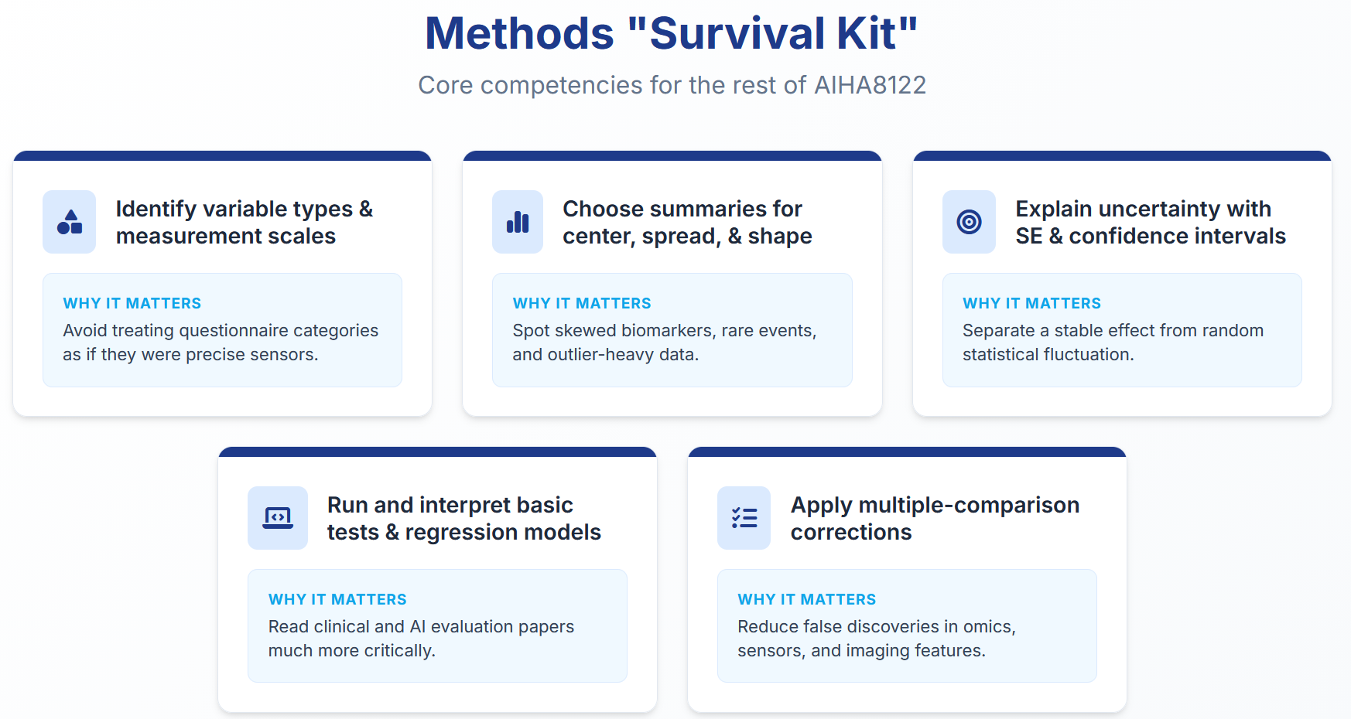
Learning Outcomes
Focus on choosing and interpreting methods, not memorizing a list of tests
4

Slide 12
AIHA8122 · Frontiers in Smart Healthy Ageing
Macao Polytechnic University
Faculty of Applied Sciences
Part I
Data and Description
What did we measure?
Who or what is the unit?
What can go wrong?
Chapter 1.1 · Foundations of Biostatistics and Probability
5

Slide 13
AIHA8122 · Frontiers in Smart Healthy Ageing
Macao Polytechnic University
Faculty of Applied Sciences
A Statistical Workflow
Research
question
Study
design
Data
collection
Analysis
plan
Evidence
report
→
→
→
→
Small example
• Question: Do daily reminders improve medication adherence?
• Design: randomized pilot or observational app-use study?
• Data: reminders sent, doses taken, age, frailty score, phone-use ability.
• Analysis: compare adherence while checking baseline imbalance and missingness.
• Report: size of improvement, uncertainty, and practical limitations.
6

Slide 14
AIHA8122 · Frontiers in Smart Healthy Ageing
Macao Polytechnic University
Faculty of Applied Sciences
What Counts as Data in AIHA?
Smart healthy ageing data are heterogeneous by default.
EHR records
diagnoses, medication lists, lab values
Wearables
steps, heart rate, sleep activity
Questionnaires
frailty score, quality of life
Images & signals
MRI, gait video, speech, home sensors
Key question: before choosing a method, ask whether the observation is a person, visit, day, sensor window, gene, image, or household.
Chapter 1.1 · Foundations of Biostatistics and Probability
7

Slide 15
AIHA8122 · Frontiers in Smart Healthy Ageing
Macao Polytechnic University
Faculty of Applied Sciences
Variables: What Are We Measuring?
A variable is a column in the dataset; the unit tells us what one row means.
Variable type
Example in ageing research
Usual statistical question
Outcome / response
Fall within 6 months
What is the event rate?
Exposure / treatment
Daily exercise group
Does the exposure change outcome?
Covariate / feature
Age, sex, baseline frailty
Do we need adjustment?
Identifier / time
Participant ID, visit date
Are repeated observations present?
Rule of thumb: define the unit before opening the statistical software.
Chapter 1.1 · Foundations of Biostatistics and Probability
8

Slide 16
AIHA8122 · Frontiers in Smart Healthy Ageing
Macao Polytechnic University
Faculty of Applied Sciences
Measurement Scales
The scale determines what summaries and models are meaningful.
Scale
Meaning
Smart health example
Safe summaries
Nominal
categories without order
sex, device brand, diagnosis group
counts, proportions
Ordinal
ordered categories
frailty level, pain score
median, ranks, proportions
Interval
equal intervals, no true zero
temperature in °C
mean, SD, differences
Ratio
true zero exists
steps/day, lab concentration
mean, ratios, log transforms
A score from 1 to 5 is not automatically interval data. Treating it as continuous is a modeling choice, not a fact.
Chapter 1.1 · Foundations of Biostatistics and Probability
9

Slide 17
AIHA8122 · Frontiers in Smart Healthy Ageing
Macao Polytechnic University
Faculty of Applied Sciences
Mini Dataset: One Week of Home Monitoring
A toy table makes the abstract terms concrete.
ID
Age
Frailty
Steps/day
Fall last year
Adherence
Read the table like a statistician:
P01
72
mild
5,230
No
86%
• What is the unit? one person.
• Which variables are ordinal?
P02
81
moderate
2,140
Yes
62%
• Which variables are binary?
P03
78
robust
7,910
No
94%
• What might be missing or biased?
• Is “steps/day” averaged over valid wear time?
P04
89
severe
980
Yes
41%
P05
76
mild
4,880
No
88%
Chapter 1.1 · Foundations of Biostatistics and Probability
10

Slide 18
AIHA8122 · Frontiers in Smart Healthy Ageing
Macao Polytechnic University
Faculty of Applied Sciences
Population vs Sample
Statistics estimates something about a target population from a smaller sample.
Target population
Study sample
●
●
●
●
●
●
●
●
●
●
●
●
●
●
●
●
●
●
●
●
●
●
●
●
●
●
●
●
●
●
●
→
●
●
●
●
●
●
●
●
●
●
●
●
●
●
●
●
●
●
●
●
●
●
●
●
●
●
●
●
●
●
Sampling bias happens when the sample does not represent the target population, such as excluding older adults without smartphones.
Chapter 1.1 · Foundations of Biostatistics and Probability
11

Slide 19
AIHA8122 · Frontiers in Smart Healthy Ageing
Macao Polytechnic University
Faculty of Applied Sciences
Descriptive Statistics: First Look
Before modeling, draw or summarize the data.
Checklist for a first data look
• How many observations?
• What is the typical value?
• How variable are the measurements?
• Are there unusual values?
• Are values skewed or clustered?
60–64
65–69
70–74
75–79
80–84
85+
Age group distribution in a community sample
Chapter 1.1 · Foundations of Biostatistics and Probability
12

Slide 20
AIHA8122 · Frontiers in Smart Healthy Ageing
Macao Polytechnic University
Faculty of Applied Sciences
Center: Mean, Median, Mode
Different centers answer different questions.
Mean
Sensitive to outliers
Median
Middle value
Mode
Most frequent category
●
●
●
●
●
●
●
●
●
●
●
●
Daily step counts: one extremely active day can pull the mean to the right.
Chapter 1.1 · Foundations of Biostatistics and Probability
13

Slide 21
AIHA8122 · Frontiers in Smart Healthy Ageing
Macao Polytechnic University
Faculty of Applied Sciences
Spread: Variability Matters
Two groups can have the same mean but very different risk profiles.
Common measures
• Range: max − min
• Interquartile range: Q3 − Q1
• Variance: average squared distance from mean
• Standard deviation: typical distance from mean
• Coefficient of variation: SD / mean
stable group
variable group
For frailty, variability can be as important as the average.
Chapter 1.1 · Foundations of Biostatistics and Probability
14

Slide 22
AIHA8122 · Frontiers in Smart Healthy Ageing
Macao Polytechnic University
Faculty of Applied Sciences
Distribution Shape
Shape tells us whether a single summary is trustworthy.
0
Approximately symmetric
Right-skewed
Zero-inflated
Biomarkers, costs, step counts, and hospitalization days are often skewed or zero-inflated.
Chapter 1.1 · Foundations of Biostatistics and Probability
15
Notes:
Teaching-data note: health measurements and numerical values are illustrative examples created for this course.
[Sources]
- OpenStax, Introductory Statistics 2e: https://openstax.org/books/introductory-statistics-2e/pages/1-introduction
- CDC, Biostatistics & Epidemiology: https://stacks.cdc.gov/view/cdc/189249/cdc_189249_DS1.pdf
[/Sources]

Slide 23
AIHA8122 · Frontiers in Smart Healthy Ageing
Macao Polytechnic University
Faculty of Applied Sciences
Outliers, Missingness, and Data Quality
Unusual values are not always errors; missing values are not always random.
●
Do not delete automatically.
Missing because the wearable was removed?
That may signal worse health, not random noise.
• Check units, range, device calibration, and duplicate records.
• Ask whether the value is clinically plausible.
• Report data quality decisions.
Chapter 1.1 · Foundations of Biostatistics and Probability
16

Slide 24
AIHA8122 · Frontiers in Smart Healthy Ageing
Macao Polytechnic University
Faculty of Applied Sciences
Part II
Probability and Sampling
What could happen?
How likely is it?
How stable is our estimate?
Chapter 1.1 · Foundations of Biostatistics and Probability
17

Slide 25
AIHA8122 · Frontiers in Smart Healthy Ageing
Macao Polytechnic University
Faculty of Applied Sciences
Probability: Uncertainty as a Number
Probability helps us talk about variation before seeing the next case.
0 ≤ P(event) ≤ 1
Example
12 of 100 similar patients fall within 6 months
Estimated risk ≈ 12%
●
●
●
●
●
●
●
●
●
●
●
●
●
●
●
●
●
●
●
●
●
●
●
●
●
●
●
●
●
●
• Probability is not certainty.
●
●
●
●
●
●
●
●
●
●
●
●
●
●
●
●
●
●
●
●
●
●
●
●
●
●
●
●
●
●
• Risk estimates depend on the population definition.
●
●
●
●
●
●
●
●
●
●
●
●
●
●
●
●
●
●
●
●
●
●
●
●
●
●
●
●
●
●
• A model prediction is useful only if it is calibrated.
●
●
●
●
●
●
●
●
●
●
Chapter 1.1 · Foundations of Biostatistics and Probability
18

Slide 26
AIHA8122 · Frontiers in Smart Healthy Ageing
Macao Polytechnic University
Faculty of Applied Sciences
Random Variables
A random variable assigns a numerical value to an uncertain outcome.
Binary
Fall: yes / no
Count
Number of hospital visits
Continuous
Systolic blood pressure
Time-to-event
Time until readmission
The variable type often suggests the first statistical model: binary → logistic, count → Poisson/negative binomial, continuous → linear/Gaussian.
Chapter 1.1 · Foundations of Biostatistics and Probability
19

Slide 27
AIHA8122 · Frontiers in Smart Healthy Ageing
Macao Polytechnic University
Faculty of Applied Sciences
Common Distributions
Distributions are simple stories for how data are generated.
Distribution
Typical outcome
Example in AIHA
Parameters
Bernoulli
yes/no event
fall within 6 months
p
Binomial
number of successes in n trials
falls among 100 patients
n, p
Poisson
event counts in time/space
ED visits per year
λ
Normal
continuous measurement
blood pressure, lab value
μ, σ
A model is a working approximation. Always check whether the approximation is reasonable for the data.
Chapter 1.1 · Foundations of Biostatistics and Probability
20

Slide 28
AIHA8122 · Frontiers in Smart Healthy Ageing
Macao Polytechnic University
Faculty of Applied Sciences
Normal Distribution
A convenient approximation for many biological measurements, not a law of nature.
X ~ N(μ, σ²)
• μ controls the center.
• σ controls the spread.
• About 68% of values fall within ±1 SD if the data are normal.
• Not suitable for counts with many zeros or strong skew.
Chapter 1.1 · Foundations of Biostatistics and Probability
21

Slide 29
AIHA8122 · Frontiers in Smart Healthy Ageing
Macao Polytechnic University
Faculty of Applied Sciences
Sampling Distribution
If we repeat a study many times, the sample statistic varies.
Sample 1
n = 30
Sample 2
n = 30
Sample 3
n = 30
→
Distribution of sample means
The standard error is the standard deviation of a statistic across repeated samples. It shrinks as n increases.
SE(mean) = SD / √n
Chapter 1.1 · Foundations of Biostatistics and Probability
22

Slide 30
AIHA8122 · Frontiers in Smart Healthy Ageing
Macao Polytechnic University
Faculty of Applied Sciences
Central Limit Theorem
Averages become more stable as sample size increases.
n = 5
n = 30
n = 100
Important nuance: CLT helps with averages, not with all statistics or all small samples.
Chapter 1.1 · Foundations of Biostatistics and Probability
23

Slide 31
AIHA8122 · Frontiers in Smart Healthy Ageing
Macao Polytechnic University
Faculty of Applied Sciences
Confidence Intervals
A confidence interval gives a plausible range for a population parameter.
estimate ± critical value × standard error
●
●
●
●
• A 95% CI does not mean there is a 95% probability that this fixed interval contains the true value.
• It means the procedure has 95% long-run coverage under its assumptions.
• Wide intervals often mean the study is not precise enough for a strong claim.
Chapter 1.1 · Foundations of Biostatistics and Probability
24

Slide 32
AIHA8122 · Frontiers in Smart Healthy Ageing
Macao Polytechnic University
Faculty of Applied Sciences
Worked Example: Mean Blood Pressure Change
Use one simple calculation to connect estimates, SE, and CI.
n = 64 older adults
Mean reduction = 4.8 mmHg
SD of change = 12.0 mmHg
SE = SD / √n = 12 / 8 = 1.5
95% CI ≈ 4.8 ± 1.96 × 1.5 = [1.9, 7.7]
Interpretation: the average reduction is estimated at 4.8 mmHg; values from about 1.9 to 7.7 mmHg are compatible with the data.
• Now ask the clinical question: is a 2–8 mmHg reduction meaningful?
• Now ask the design question: was this randomized or observational?
• Now ask the data question: were dropouts balanced across groups?
Chapter 1.1 · Foundations of Biostatistics and Probability
25

Slide 33
AIHA8122 · Frontiers in Smart Healthy Ageing
Macao Polytechnic University
Faculty of Applied Sciences
Part III
Inference and Basic Tests
What is the null?
How surprising is the result?
How large is the effect?
Chapter 1.1 · Foundations of Biostatistics and Probability
26

Slide 34
AIHA8122 · Frontiers in Smart Healthy Ageing
Macao Polytechnic University
Faculty of Applied Sciences
Hypothesis Testing: Core Logic
A test quantifies how incompatible the data are with a null hypothesis.
1
Set H₀ and H₁
→
2
Choose test statistic
→
3
Compute p-value
→
4
Interpret with context
Example: Does a balance-training program reduce average fall-risk score compared with usual care?
A test does not measure importance. It measures surprise under a model.
Chapter 1.1 · Foundations of Biostatistics and Probability
27

Slide 35
AIHA8122 · Frontiers in Smart Healthy Ageing
Macao Polytechnic University
Faculty of Applied Sciences
p-Value: What It Means
A p-value is a probability calculated under the null hypothesis.
p = P(data as extreme or more extreme | H₀)
Do not say:
Tail area: “more extreme” results
• p = 0.03 means the hypothesis is 3% likely.
• p < 0.05 proves a clinically meaningful effect.
Better:
• Under H₀, results this extreme would be uncommon.
• Report the effect size and CI together with the p-value.
Chapter 1.1 · Foundations of Biostatistics and Probability
28
Notes:
[Sources]
- OpenStax, Introductory Statistics 2e: https://openstax.org/books/introductory-statistics-2e/pages/1-introduction
- NIST/SEMATECH e-Handbook of Statistical Methods: https://doi.org/10.18434/M32189
- American Statistical Association, Statement on Statistical Significance and P-Values: https://www.amstat.org/asa/files/pdfs/p-valuestatement.pdf
[/Sources]

Slide 36
AIHA8122 · Frontiers in Smart Healthy Ageing
Macao Polytechnic University
Faculty of Applied Sciences
Type I and Type II Errors
Every decision rule can be wrong in two different ways.
Reality
Reject H₀
Do not reject H₀
• α is often set before analysis, commonly 0.05.
H₀ true
Type I error
false positive
Correct
• Power depends on effect size, sample size, variability, and α.
• Low-powered studies miss real effects and exaggerate found effects.
H₀ false
Correct
power = 1 − β
Type II error
false negative
Chapter 1.1 · Foundations of Biostatistics and Probability
29

Slide 37
AIHA8122 · Frontiers in Smart Healthy Ageing
Macao Polytechnic University
Faculty of Applied Sciences
Statistical Power
Power is the chance to detect a real effect of a specified size.
• Larger sample size increases power.
• Larger true effect increases power.
power
• Lower variability increases power.
• Underpowered studies can miss real effects or exaggerate found effects.
sample size
Chapter 1.1 · Foundations of Biostatistics and Probability
30

Slide 38
AIHA8122 · Frontiers in Smart Healthy Ageing
Macao Polytechnic University
Faculty of Applied Sciences
t-Tests: Comparing Means
Use t-tests when the question is about average differences.
One-sample
mean vs known value
Paired
before vs after in same person
Two-sample
group A vs group B
t = (estimate − null value) / SE
Always report the mean difference and confidence interval, not only p < 0.05.
Chapter 1.1 · Foundations of Biostatistics and Probability
31

Slide 39
AIHA8122 · Frontiers in Smart Healthy Ageing
Macao Polytechnic University
Faculty of Applied Sciences
ANOVA: Comparing More Than Two Means
ANOVA asks whether at least one group mean differs.
• Global F-test asks: is any difference present?
• Post-hoc comparisons ask: which groups differ?
• Control multiplicity when testing many pairs.
• ANOVA assumptions: independence, approximate normality, similar variances.
control
light
moderate
intensive
Mean frailty score after intervention
Chapter 1.1 · Foundations of Biostatistics and Probability
32

Slide 40
AIHA8122 · Frontiers in Smart Healthy Ageing
Macao Polytechnic University
Faculty of Applied Sciences
χ² and Fisher’s Exact Test
Use these tests for associations between categorical variables.
Training
Fall
No fall
Total
• χ² test needs adequate expected counts.
Program
14
86
100
• Fisher’s exact test is safer for small samples.
• Report proportions and risk differences when useful.
Usual care
23
77
100
• Association is not automatically causation.
Total
37
163
200
Classroom prompt: which number is the event rate in each group?
Chapter 1.1 · Foundations of Biostatistics and Probability
33

Slide 41
AIHA8122 · Frontiers in Smart Healthy Ageing
Macao Polytechnic University
Faculty of Applied Sciences
Nonparametric Tests
When assumptions are weak, rank-based tests can be useful.
Two groups
Mann–Whitney U
Paired data
Wilcoxon signed-rank
More than two groups
Kruskal–Wallis
• Good for skewed outcomes or ordinal scales.
• Tests differences in distributions, not always medians in the simple sense.
• Still requires thoughtful design and clear reporting.
Chapter 1.1 · Foundations of Biostatistics and Probability
34

Slide 42
AIHA8122 · Frontiers in Smart Healthy Ageing
Macao Polytechnic University
Faculty of Applied Sciences
Part IV
Association, Models, and Reporting
How variables move together
How to adjust
How to report responsibly
Chapter 1.1 · Foundations of Biostatistics and Probability
35

Slide 43
AIHA8122 · Frontiers in Smart Healthy Ageing
Macao Polytechnic University
Faculty of Applied Sciences
Correlation
Correlation measures the strength and direction of linear association.
−1 ≤ r ≤ 1
• Positive: variables increase together.
●
●
●
●
• Negative: one increases as the other decreases.
●
●
●
●
●
●
●
●
• Zero correlation does not imply no relationship.
●
●
●
●
• Correlation does not imply causation.
positive
Chapter 1.1 · Foundations of Biostatistics and Probability
36

Slide 44
AIHA8122 · Frontiers in Smart Healthy Ageing
Macao Polytechnic University
Faculty of Applied Sciences
Linear Regression
Regression models the expected value of a continuous outcome.
Y = β₀ + β₁X + ε
• β₁: expected change in Y for a one-unit increase in X.
●
• Adjustment adds covariates to compare similar participants.
●
●
●
●
• Check assumptions and avoid over-interpreting causality.
●
●
●
●
Chapter 1.1 · Foundations of Biostatistics and Probability
37

Slide 45
AIHA8122 · Frontiers in Smart Healthy Ageing
Macao Polytechnic University
Faculty of Applied Sciences
Logistic Regression
Logistic regression models a binary outcome such as fall/no fall.
logit(p) = log(p / (1 − p))
• Output is often reported as an odds ratio.
• Predicted probabilities are usually easier for clinicians to understand.
• Calibration matters: predicted risks should match observed risks.
Chapter 1.1 · Foundations of Biostatistics and Probability
38

Slide 46
AIHA8122 · Frontiers in Smart Healthy Ageing
Macao Polytechnic University
Faculty of Applied Sciences
Multiple Comparisons
When many tests are run, some small p-values appear by chance.
If 100 true-null tests are run at α = 0.05, expect about 5 false positives.
.73
.42
.19
.04
.88
.61
.03
.28
.91
.55
.12
.07
.22
.01
.49
.36
.67
.15
.02
.80
• High-dimensional omics: thousands of genes.
• Wearables: many windows, outcomes, and thresholds.
• Imaging: many voxels, regions, or features.
• Multiplicity correction is not optional in exploratory testing.
Chapter 1.1 · Foundations of Biostatistics and Probability
39

Slide 47
AIHA8122 · Frontiers in Smart Healthy Ageing
Macao Polytechnic University
Faculty of Applied Sciences
Multiple-Comparison Corrections
Use the correction that matches the scientific goal.
Method
Controls
Idea
When to use
Bonferroni
FWER
α / m threshold
Small number of confirmatory tests; very conservative
Holm
FWER
Step-down adjusted thresholds
Confirmatory tests when Bonferroni is too strict
Benjamini–Hochberg
FDR
Rank p-values and control expected false discovery proportion
Omics, sensors, imaging, exploratory discovery
Take-home messages: describe before testing; report effect sizes and confidence intervals; choose tests from the data structure; adjust for multiplicity when many hypotheses are tested.
Bridge to next section: association is not causation. Causal inference formalizes what additional assumptions are needed.
Chapter 1.1 · Foundations of Biostatistics and Probability
40

Slide 48

CAUSAL INFERENCE
Causal Inference for
AI-Driven Smart Health and Elderly Care

Slide 49
01
Why We Need Causal Inference
Clinical AI needs evidence about actions, not only accurate prediction.

Slide 50
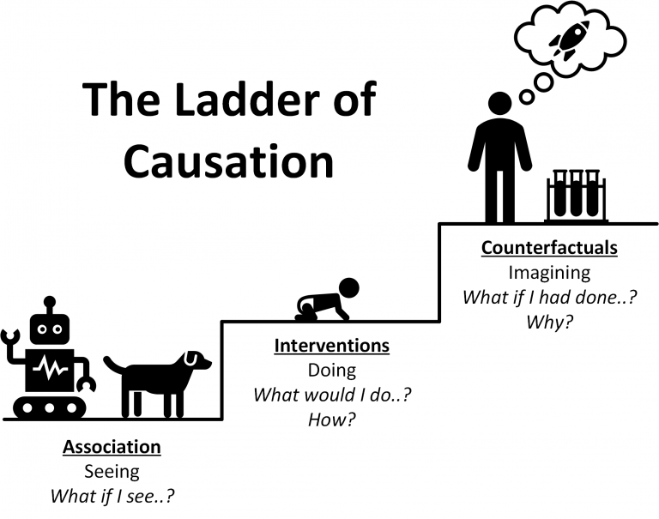
Why We Need Causal Inference
Association, intervention, and counterfactual questions
1
Association
2
Intervention
3
Counterfactual

Slide 51
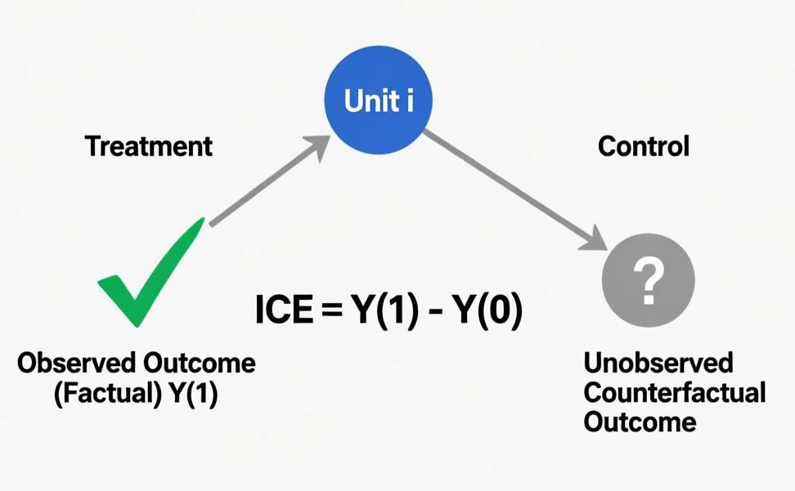
Why We Need Causal Inference
core problem: we can never simultaneously observe the two outcomes for the same individual—both receiving the treatment and not receiving it.
Potential Outcomes Framework
Therefore: the essence of the causal effect is a “missing data” problem.

Slide 52
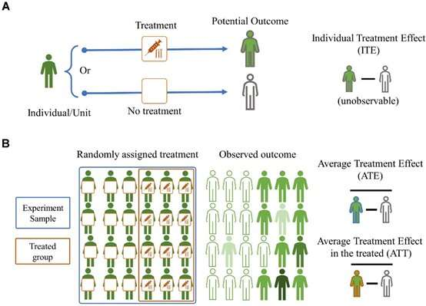
From ITE to ATE
Given that we cannot calculate individual effects, is it possible to estimate the average effect across the population?

Slide 53
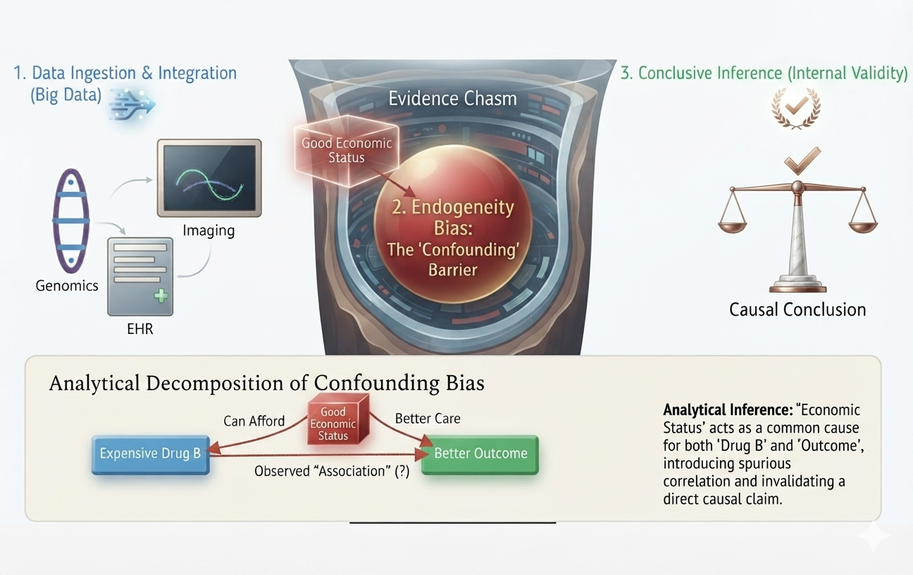
Why We Need Causal Inference
Big data versus big evidence
03

Slide 54

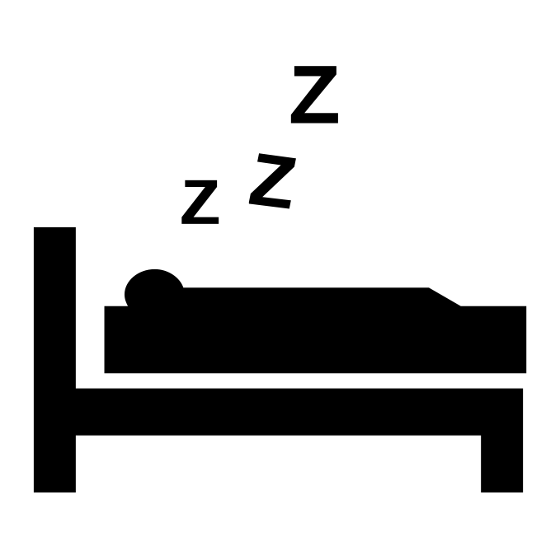

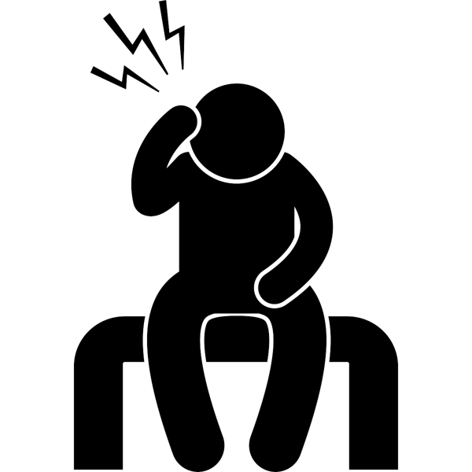

Why We Need Causal Inference
Correlation does not imply causation
Sleeping with shoes on is strongly correlated with waking up with a headache
Common cause: drinking the night before
Shoe-sleepers differ from non-shoe-sleepers in a key way
Confounding
Total association (e.g. correlation):
mixture of causal and confounding association
Causal association

Slide 55

Why We Need Causal Inference
Aggregated Population Data
Common Interpretations & Explanations
Smoking Status | Cancer | Non-Cancer | Total | Risk Rate
Non-Smoker | 100 | 100 | 200 | 50.0%
Smoker | 80 | 120 | 200 | 40.0%
Presence of Confounding Factor
Gender/Gene affects both smoking exposure and baseline cancer incidence, acting as a true confounder.
Risk Difference (RD) Calculation:
(Apparent Illusion: Smoking lowers overall risk?)
Stratified Data (Controlled for Gender/Gene)
Lack of Group Comparability
Male baseline risk is far higher than female risk, and smoking proportions are heavily unbalanced across strata.
Group | Cancer | Non-Cancer | Risk Rate
Non-Smoker | 90 | 60 | 60.0%
Smoker | 35 | 15 | 70.0%
Group | Cancer | Non-Cancer | Risk Rate
Non-Smoker | 10 | 40 | 20.0%
Smoker | 45 | 105 | 30.0%
Unequal Subgroup Distribution
Disproportionate sample weights (most males didn't smoke, most females smoked) severely distort marginal risk.
Epidemiological Standardization
Standardized rates or multivariate stratified models must be applied to eliminate confounding bias.

Slide 56
Why we need Causal Inference: Low Birth Weight Paradox
Expected Chain: Maternal Smoking → Low Birth Weight → Increased Infant Mortality Rate.
Low birth weight
The Paradox: Among low birth weight infants, infants of smokingmothers have LOWER mortality than infants of non-smoking mothers!
Smoking
Mortality
Unobserved Defects: Birth defects cause low birth weight AND severe mortality.
Low birth weight
Unknown
Collider Stratification: Stratifying on an intermediate variable (Low Birth Weight) opens a spurious non-causal path between Smoking and Birth Defects.
Smoking
Mortality
Epldemlologlcal Consensus: After 40 years of debate,DAGs proved that pregnant women SHOULD NOT smoke!

Slide 57
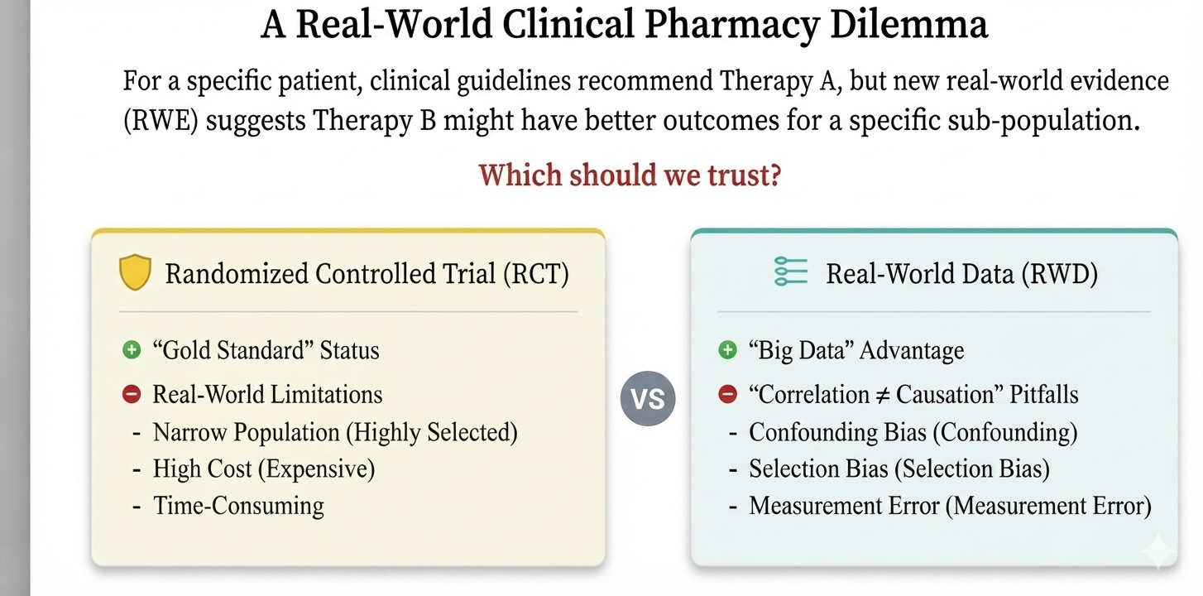
Why we need Causal Inference

Slide 58
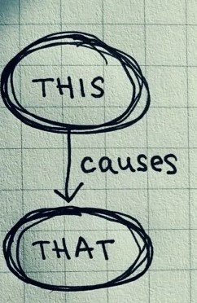

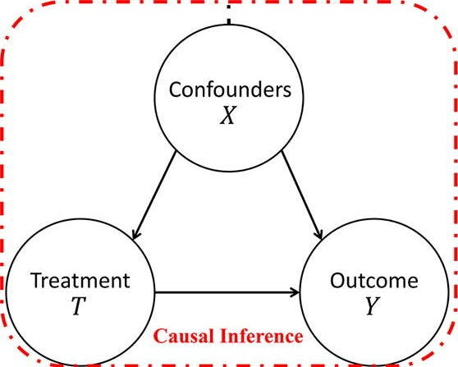
Causal Inference
Nobel Prize, 2021 in Economics
Causal inference is the process of determining the causal effect of one variable on another
02

Slide 59
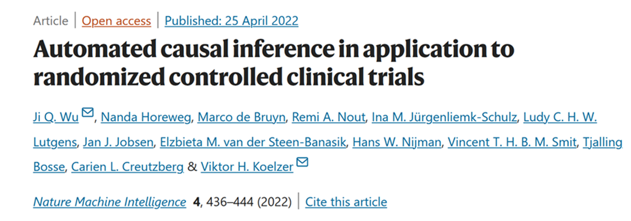
Causal inference in RCT

Slide 60
02
What Is Causal Inference?
The language of interventions, potential outcomes, DAGs, and estimands.

Slide 61
Causal roadmap
1
2
3
4
5
6
Why causal inference?
Core language
Design first
Estimators
Beyond static treatment
AI and cases
Paradoxes, clinical decisions, and the limit of prediction
Potential outcomes, DAGs, interventions, estimands
Target trial emulation and bias prevention
Regression, matching, weighting, doubly robust learning
Longitudinal, multiple, categorical, and continuous interventions
Causal ML, sensitivity analysis, pharmacy and ageing applications
Guiding idea: a causal study is not a predictive model with a causal label; it is a carefully designed comparison of well-defined interventions.

